Slide 1
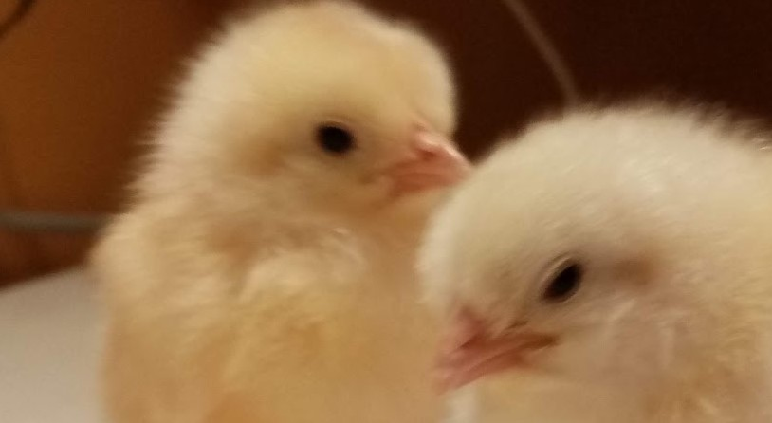
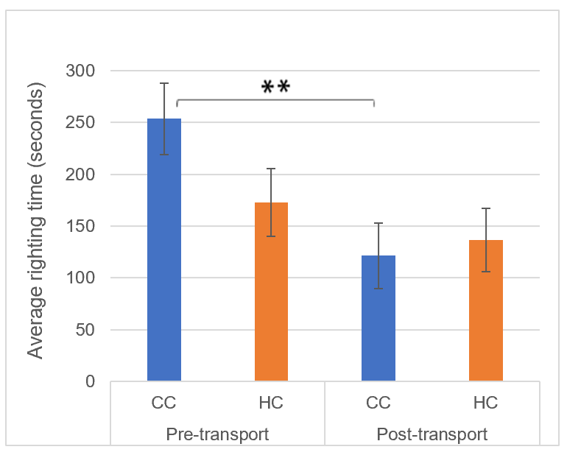
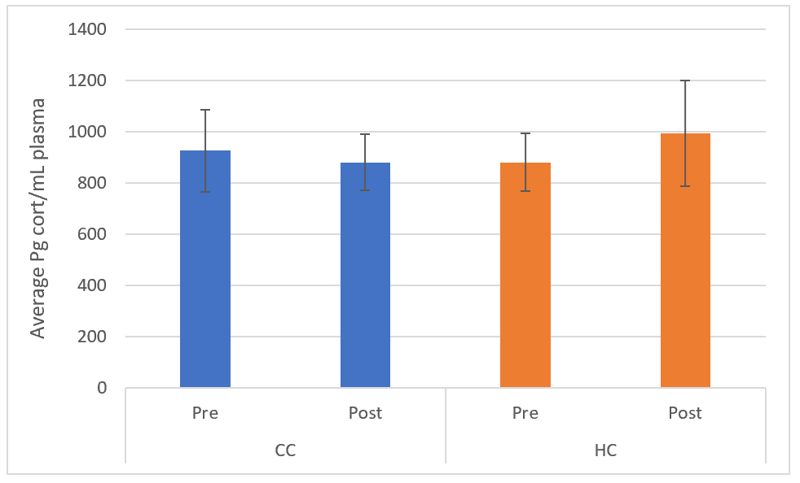
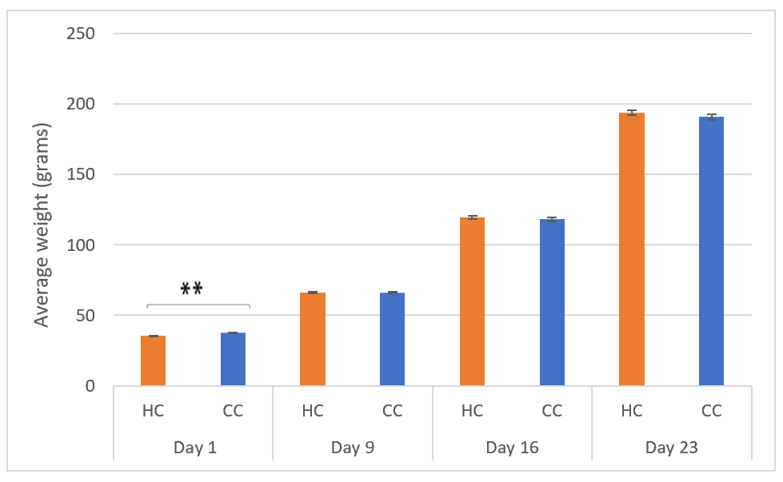
Effects of commercial hatchery processes on the stress response in domestic chicken
Hedvika Suchankova
Supervisors: Per Jensen and Enya van Poucke
Introduction
Early life stress can significantly affect lifetime welfare by decreased growth, delayed sexual maturation, increased aggression, and among others suppressed immune system. Exacerbated stress and fear responses may be indicators of early life stress. Evaluation of the long-term effects of the current commercial hatchery processes on the stress response may provide an insight into the welfare of laying hens.
Methods
White Leghorn hybrids from the same parental stock were used. Hatchery processed (HC) group experienced standard practices while hatchery non-processed (CC) chicks were reared at LiU facilities.
Tests:
Weekly weighing (for nine weeks)
Transport stressor (week five) with tonic immobility (TI) test after one day
Permanent regrouping stress of all pens (week 8) with corticosterone (CORT)
measurement after
two days, CC (N = 25),
HC (N = 25)
Figure 1. TI induction procedure (left). Chicken induced in TI (right).
Results
Weighing: No significant differences between the groups except on Day 1.
Tonic immobility: No significant difference in the righting times between groups. CC group had significantly shorter time post-transport.
CORT levels: There was no significant effect of regrouping on the blood CORT within or between the groups.
Figure 2. Asterisks signify P < 0.001. Average righting times of each group during TI test before and after transport, CC (N = 20), HC (N = 20) (left). Average blood plasma CORT concentrations of each group before and after regrouping, CC (N = 25), HC (N = 25) (middle). Average weight of each group from the first day to the third week (right).
Conclusions
Commercial hatchery processes, though highly stressful, did not have significant impact on the coping mechanisms and long-term stress responses, showing substantial resilience in the White Leghorn hybrids.
Previous studies on hatchery practices identified differences in the immediate stress reponses to stressors, implying potential long-term impacts. Further research all the way into adulthood would shed more light on the effects of commercial processes on the welfare of laying hens.

